Slide 1
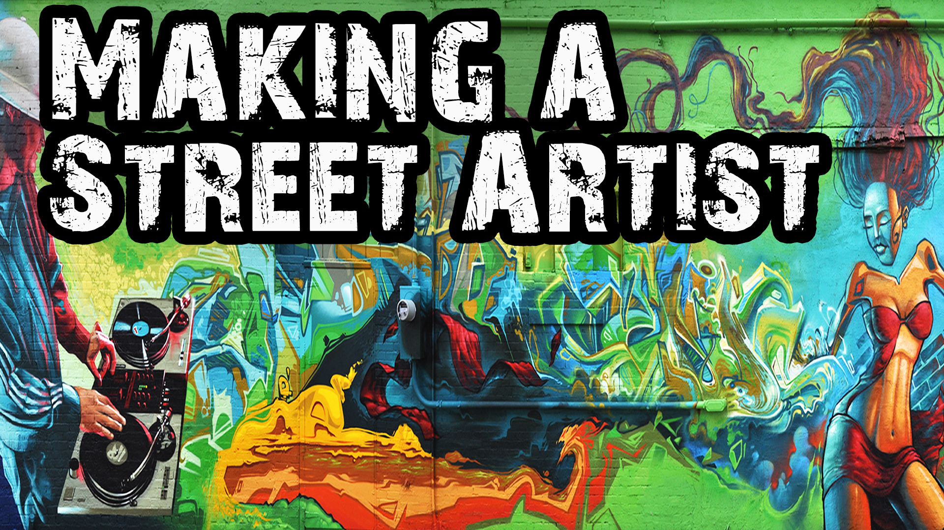
DAN THOMPSON
VINING
redefining the landscape
SPRAY PAINT AND MURAL ART

Slide 2
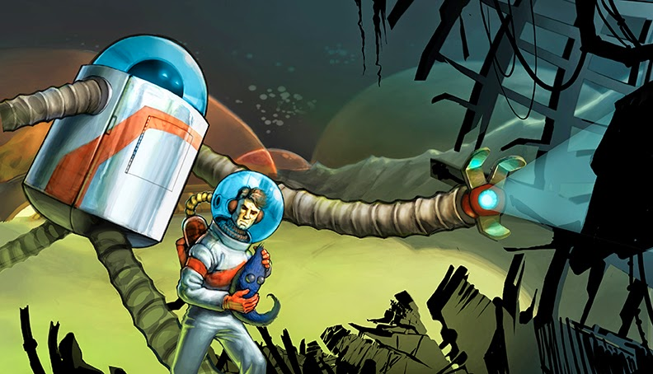
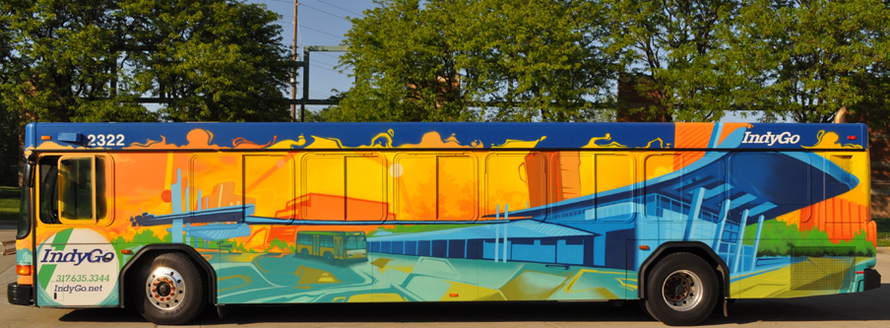
Graffiti: Crime, art, or both?
Group Talk
Do you see graffiti around your neighborhood, school, or community?
How does it make you feel when you see it?

Slide 3
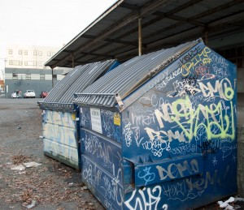
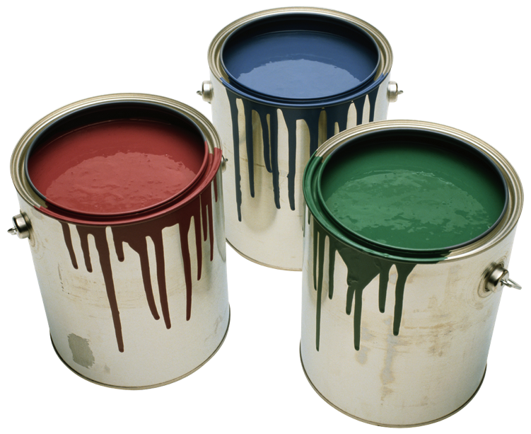
Where do you stand?
Think Pair Share
Is graffiti art or vandalism?
Turn to a partner and discuss what you think, and, more importantly, why you think it.
Not sure where you stand? Maybe these resources will help.
http://www.muralarts.org/
http://iml.jou.ufl.edu/projects/fall07/sanchez/index.html

Slide 4
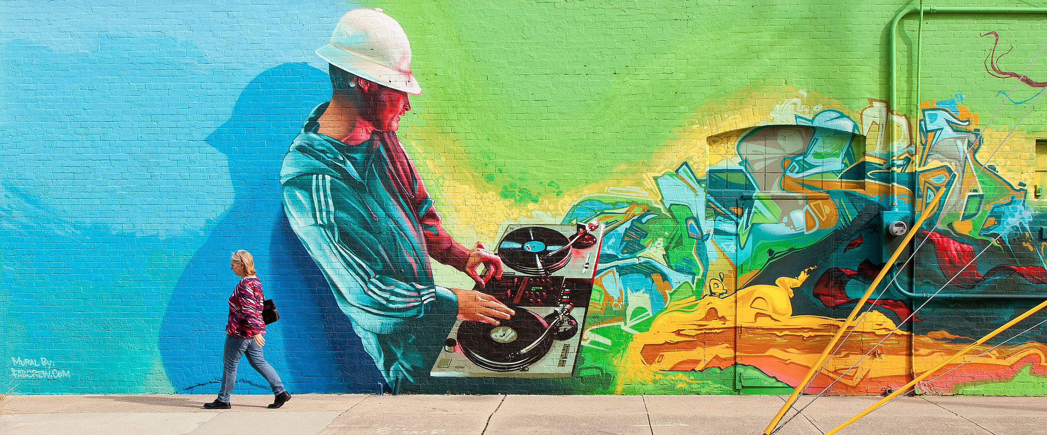
Where do you stand? Let’s take a Picture Walk.
Look at the images on the following slides.
Which ones do you think which might be viewed as crimes? Which ones do you think are art?
http://nomeancity.com/the-cats-pajamas

Slide 5
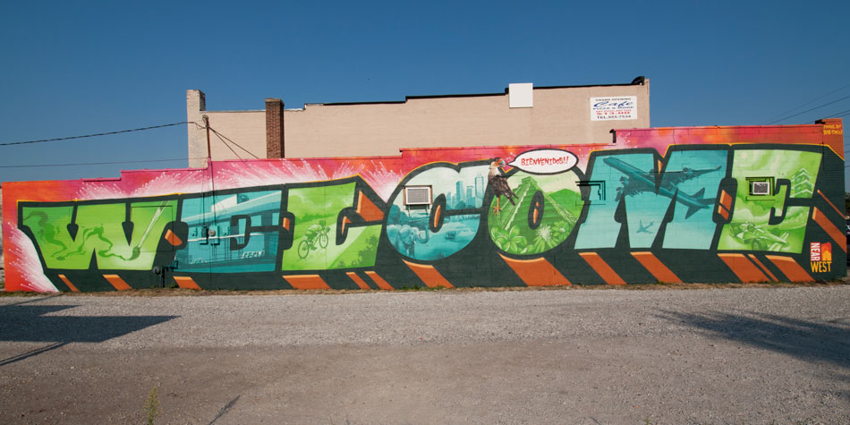
http://fabcrew.com/letter-styles.aspx

Slide 6
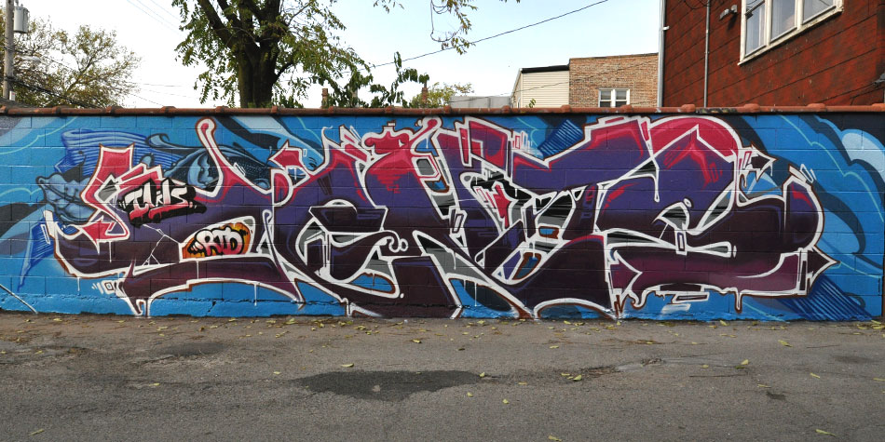
http://fabcrew.com/letter-styles.aspx

Slide 7
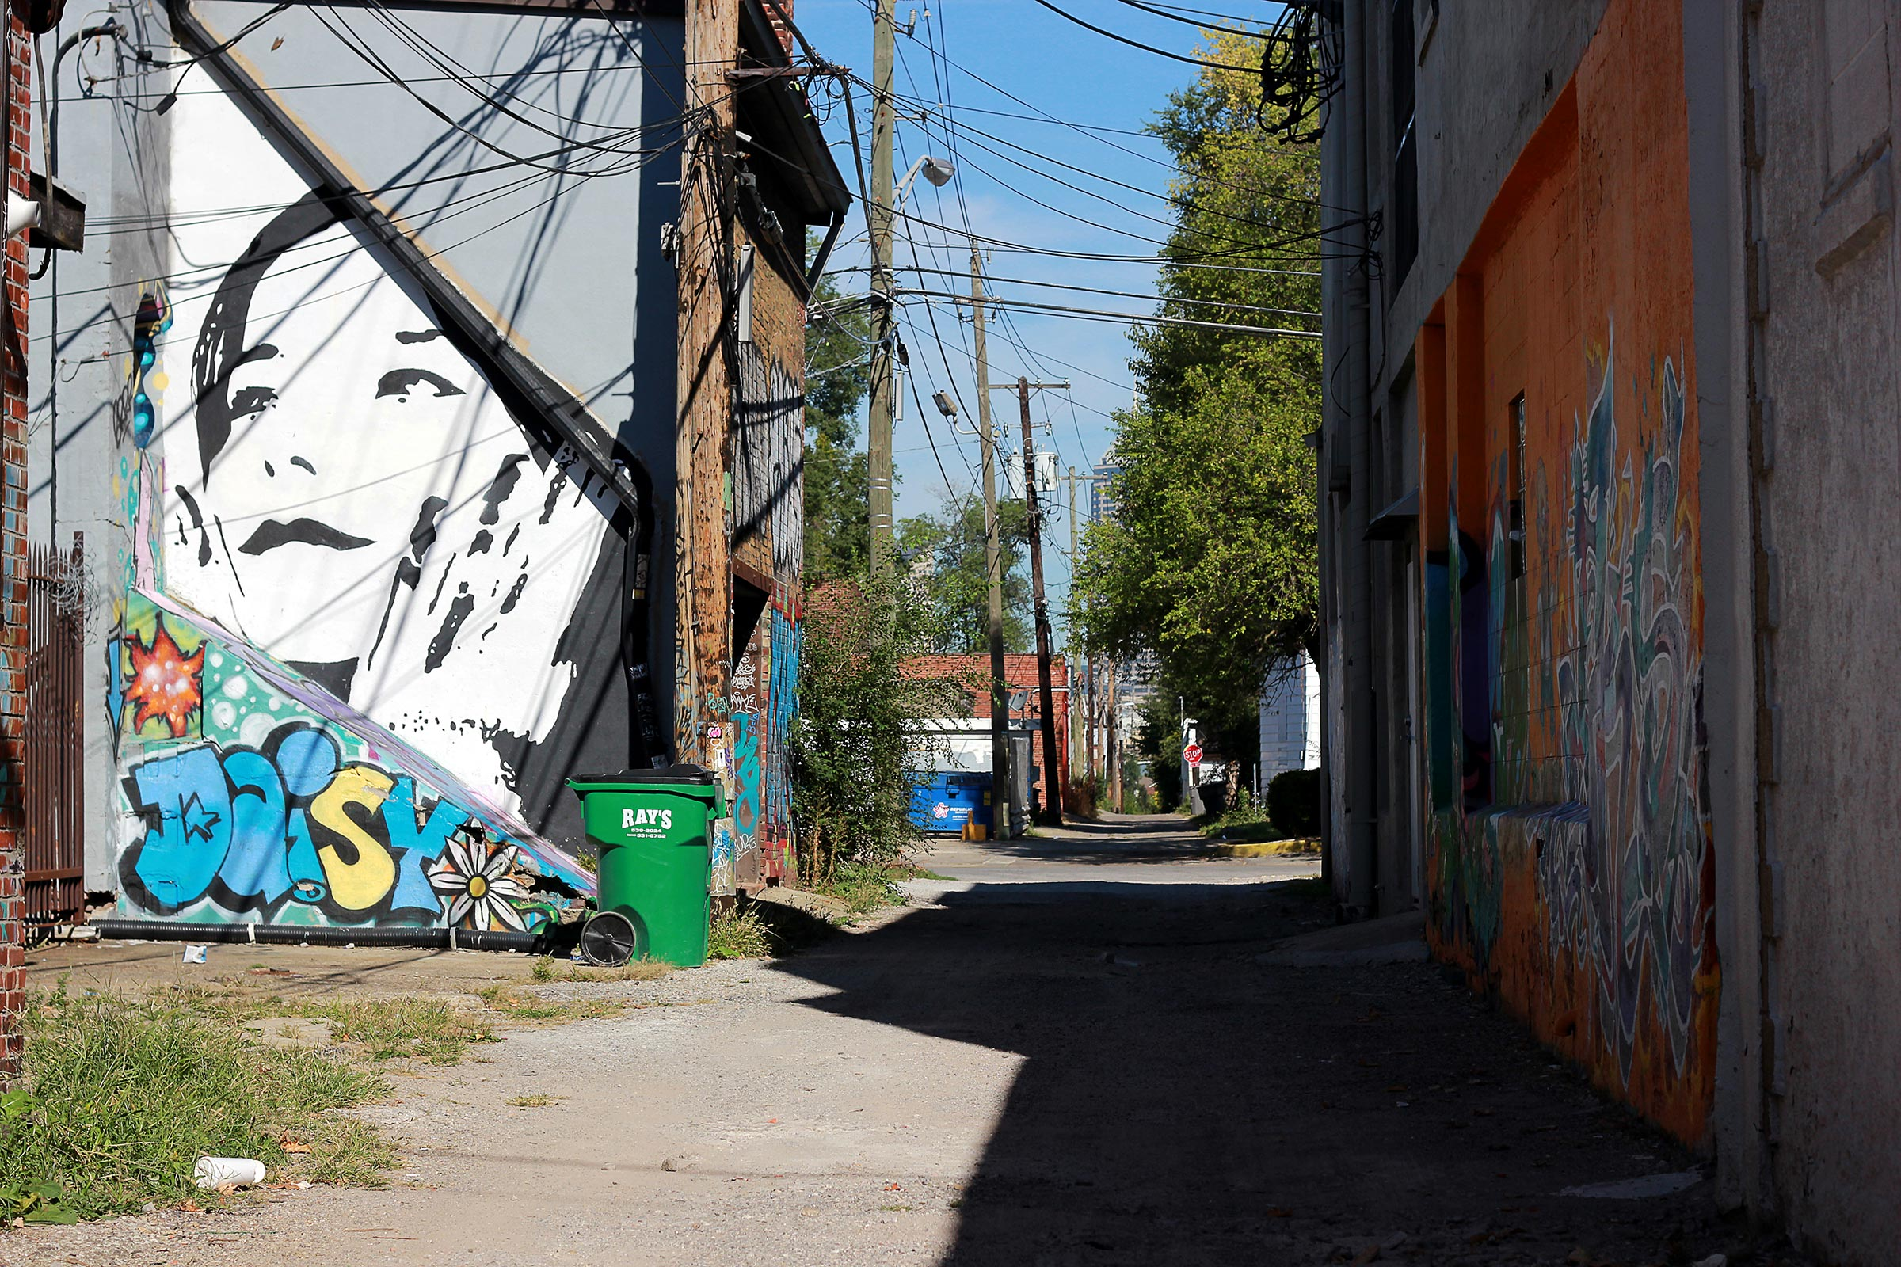
http://pivotmarketing.com/off-the-beaten-path-2/

Slide 8
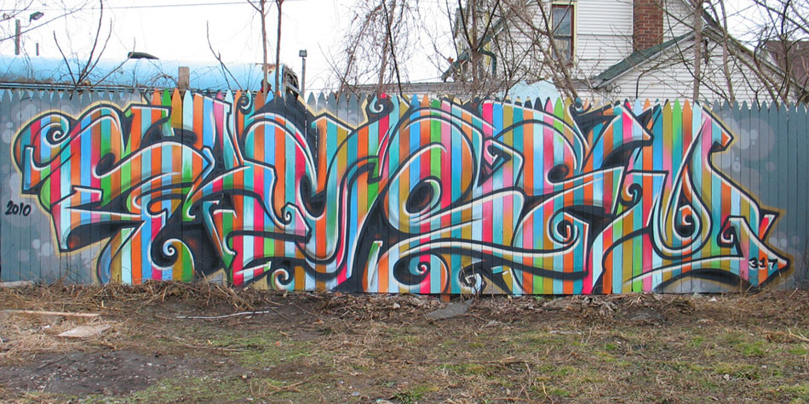
http://fabcrew.com/letter-styles.aspx

Slide 9
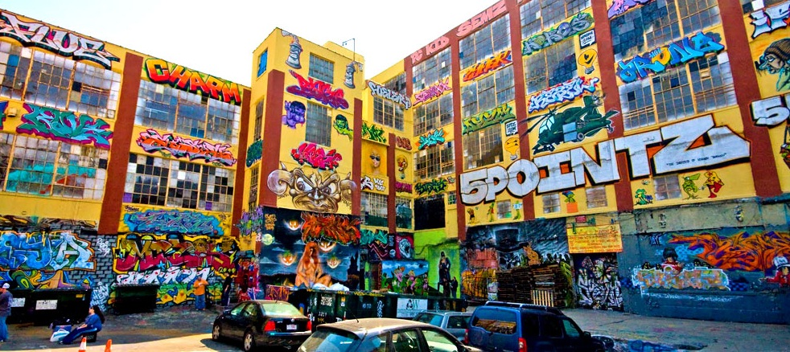
http://www.museumofthecity.org/wp-content/uploads/2014/11/phun_phactory.jpg

Slide 10
The key terms of the debate
Vandalism: The destruction or damaging of
someone else’s property
Tagging: A term used for writing the name of an
artist or group in graffiti
Postmodern lens: The idea that just about anything
can be art
Why is understanding each one of these terms important when deciding if graffiti is art or a crime?

Slide 11
Team reading
Organize into groups of 4
Team read the this article,
http://www.museumofthecity.org/project/graffiti-art-or-vandalism/
Specifically the sections entitled “the art of vandalism”
and “what is art?”
Make sure to pause after each section and make meaning out of what you read

Slide 12
The great debate
Create Create two groups for the class
Group 1: Graffiti is a crime
Group 2: Graffiti is art
Rules of the debate:
Give the groups time to organize their thinking around their group topic.
Raise your hand if you want to speak.
No group can speak two times in a row.
You will always have a chance for rebuttal to what the other group has said.
Finish with a closing argument.

Slide 13
Digging Deeper together
What about the history of public art? Has the government helped to support murals and other kinds of public art?
Are there mural artists in my community?
How many schools in our district have murals in them, and how were they created?
What are the benefits of having public art in our communities?
Why has graffiti been illegal for so long?
What about the history of public art? Has the government helped to support murals and other kinds of public art?
Are there mural artists in my community?
How many schools in our district have murals in them, and how were they created?
Has anybody found out what the benefits of having public art around are?
has graffiti been illegal for so long?
What about the history of public art? Has the government helped to support murals and other kinds of public art?
Are there mural artists in my community?
How many schools in our district have murals in them, and how were they created?
Has anybody found out what the benefits of having public art around are?

Slide 14
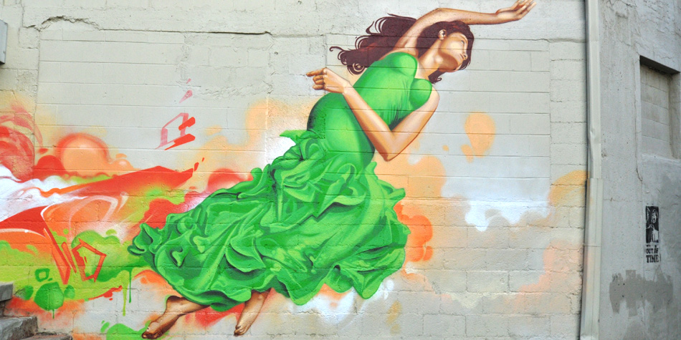
Have you thought About…
Having a mural at your school? It’s easier than you think. All you need is a group of students willing to undertake the task, some awesome adults to support them, and a blank wall so you can create!
Why not have a contest to see whose drawing gets to be turned into the school mural? Then, get everyone together to help pitch in, with some support from your art teacher you can do it! The best part? The art becomes a part of that school forever, now that’s powerful!
Images from http://fabcrew.com/

Slide 15
project #1: Calligraphy
https://www.youtube.com/watch?v=6BHPAVAJME8&feature=youtu.be
What you’ll need: thick watercolor paper, paint markers, pencil for sketching, colored pencils, and a ruler
Remember, sketch out your design first. This can be your name, the name of your school, a team you play on, really any words!
Next, add some color around the words with your colored pencils
Fill in your letters with the pens, and put any kinds of accents on your work that you want!

Slide 16
Project #2: Spray paint art
Check out another awesome project from this video series

Slide 17
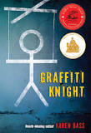
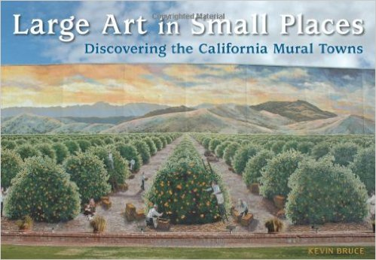
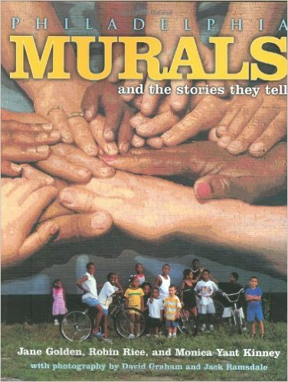
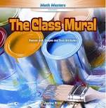
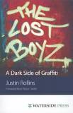
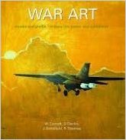
Books for Further reading
The Lost Boyz: A Dark Side of Graffiti (Justin Rollins)
Graffiti Knight (Karen Bass)
The Class Mural: Reason with Shapes and Their Attributes (Justine Price)
Philadelphia Murals and the Stories they Tell (Jane Golden)
Large Art in Small Places: Discovering the California Mural Towns (Kevin Bruce)
War Art: Murals and Graffiti- Military Life, Power, and Subversion (Wayne Cocroft)

Slide 18
educational standards
Within every episode we strive to meet every content standard within the National Core Arts Standards. Please be sure to include and reference these standards when preparing and documenting your lessons. For additional, and more in-depth information, you can reference this site.
Associated Anchor Standards
Creating
#VA:Cr1.1
Anchor Standard: Generate and conceptualize artistic ideas and work.
Enduring Understanding: Creativity and innovative thinking are essential life skills that can be developed.
Essential Question: What conditions, attitudes, and behaviors support creativity and innovative thinking? What factors prevent or encourage people to take creative risks? How does collaboration expand the creative process?
#VA:Cr1.2
Anchor Standard: Generate and conceptualize artistic ideas and work.
Enduring Understanding: Artists and designers shape artistic investigations, following or breaking with traditions in pursuit of creative art-making goals.
Essential Question: How does knowing the contexts histories, & traditions of art forms help us create works of art & design? Why do artists follow or break from established traditions? How do artists determine what resources are needed to formulate artistic investigations.
#VA:Cr2.1
Anchor Standard: Organize and develop artistic ideas and work.
Enduring Understanding: Artists and designers experiment with forms, structures, materials, concepts, media, and art-making approaches.
Essential Question: How do artists work? How do artists and designers determine whether a particular direction in their work is effective? How do artists and designers learn from trial and error?

Slide 19
educational standards
Creating
#VA:Cr2.3
Anchor Standard: Organize and develop artistic ideas and work.
Enduring Understanding: People create and interact with objects, places, and design that define, shape, enhance, and empower their lives.
Essential Question: How do objects, places, and design shape lives and communities? How do artists and designers determine goals for designing or redesigning objects, places, or systems? How do artists and designers create works of art or design that effectively communicate
#VA:Cr3.1
Anchor Standard: Refine and complete artistic work.
Enduring Understanding: Artist and designers develop excellence through practice and constructive critique, reflecting on, revising, and refining work over time.
Essential Question: What role does persistence play in revising, refining, and developing work? How do artists grow and become accomplished in art forms? How does collaboratively reflecting on a work help us experience it more completely?

Slide 20
educational standards
Responding
#VA:Re7.1
Anchor Standard: Perceive and analyze artistic work.
Enduring Understanding: Individual aesthetic and empathetic awareness developed through engagement with art can lead to understanding and appreciation of self, others, the natural world, and constructed environments.
Essential Question: How do life experiences influence the way you relate to art? How does learning about art impact how we perceive the world? What can we learn from our responses to art?
#VA:Re7.2
Anchor Standard: Perceive and analyze artistic work.
Enduring Understanding: Visual imagery influences understanding of and responses to the world.
Essential Question: What is an image? Where and how do we encounter images in our world? How do images influence our views of the world?
#VA:Re8.1
Anchor Standard: Interpret intent and meaning in artistic work.
Enduring Understanding: People gain insights into meanings of artworks by engaging in the process of art criticism.
Essential Question: What is the value of engaging in the process of art criticism? How can the viewer "read" a work of art as text? How does knowing and using visual art vocabularies help us understand and interpret works of art?
#VA:Re7.2
Anchor Standard: Perceive and analyze artistic work.
Enduring Understanding: Visual imagery influences understanding of and responses to the world.
Essential Question: What is an image? Where and how do we encounter images in our world? How do images influence our views of the world?

Slide 21
educational standards
Connecting
#VA:Cn11.1
Anchor Standard: Relate artistic ideas and works with societal, cultural, and historical context to deepen understanding.
Enduring Understanding: People develop ideas and understandings of society, culture, and history through their interactions with and analysis of art.
Essential Question: How does art help us understand the lives of people of different times, places, and cultures? How is art used to impact the views of a society? How does art preserve aspects of life?
#VA:Re8.1
Anchor Standard: Interpret intent and meaning in artistic work.
Enduring Understanding: People gain insights into meanings of artworks by engaging in the process of art criticism.
Essential Question: What is the value of engaging in the process of art criticism? How can the viewer "read" a work of art as text? How does knowing and using visual art vocabularies help us understand and interpret works of art?
copyright 2016 Artrageous with Nate, LLC.

Slide 22
Educational Standards
NCSS Standards
1: Culture
3: People, Places, and Environments
4: Individual Development and Identity
5: Individuals, Groups, and Institutions
6: Power, Authority, and Governance
10: Civic Ideals and Practices

Slide 23
Educational Standards
National Science Standards
K: Interdependent Relationships in Ecosystems: Animals, Plants, and Their Environment
1: Structure, Function and Information Processing
2: Interdependent Relationships in Ecosystems
3: Interdependent Relationships in Ecosystems
4: Structure, Function, and Information Processing
5: Matter and Energy in Organisms and Ecosystems

